Slide 1
Development of master curricula for natural disasters risk management in Western Balkan countries
Accreditation of master curricula
Slaviša Trajković, Snežana Đorić-Veljković University of Niš
Belgrade, Serbia, 8th March 2018
Project number: 573806-EPP-1-2016-1-RS-EPPKA2-CBHE-JP
"This project has been funded with support from the European Commission. This publication reflects the views only of the author, and the Commission cannot be held responsible for any use which may be made of the information contained therein"

Slide 2
Higher education accreditation is a type of
quality assurance process during which services and operations of post-secondary educational institutions or programs are evaluated by an external body (commission, agency …) to determine if the standards are achieved.
If standards are met, accredited status is granted
by the agency or commission.
In many countries the function of educational accreditation for higher education is provided by a government organizations, such as a ministry of education, councils, commissions …

Slide 3
System of Quality Assurance
The Law on Higher Education (2005, 2010, 2015, 2017)
Conference of Serbian Universities
NATIONAL ASSEMBLY
NATIONAL COUNCIL OF HIGHER EDUCATION
21 members
Conference of professional schools principals
COMMISSION FOR ACCREDITATION AND QUALITY ASSURANCE (CAQA) 15 members
MINISTRY OF EDUCATION, SCIENCE AND TECHNOLOGY DEVELOPMENT
INSTITUTIONS OF HIGHER EDUCATION

Slide 4
System of Quality Assurance
The Law on Higher Education
Government of Serbia
National accreditation body - for accreditation and quality assurance
COMMISSION FOR ACCREDITATION AND QUALITY ASSURANCE (CAQA) 15 17 members
INSTITUTIONS OF HIGHER EDUCATION

Slide 5
Development of master curricula for natural disasters risk management in Western Balkan countries
The initial accreditation - carried out in accordance with the Procedure for the Initial Accreditation for Performing Higher Education Activity.
The procedure starts with the applicant submitting a request for performing higher education activity.
HEIs: -Self-evaluation (3 years)
CAQA:
-Accreditation of HEIs and study programs (5 years 7 years)
-External quality evaluation of HEIs (between two accreditations)

Slide 6
The Accreditation Procedure
Institution submits the accreditation request supported by the data and documents
CAQA forms a sub-commission (1student)
CAQA designates two reviewers for the institution and each study program
The sub-commission
visits the institution-report
The reviewers submit reports to the sub-commission
The sub-commission makes a draft report and presents it to CAQA
CAQA makes the accreditation decision
Postpones the decision
and gives an act of warning to the institution
Accepts the accreditation request and grants the
Accreditation Certificate
Rejects the accreditation
Appeal to the National Council of Higher Education
Operating licenses (Miinistry)

Slide 7
Development of master curricula for natural disasters risk management in Western Balkan countries
Quality assurance is based on:
standards for self-evaluation and quality assurance of higher education institution
standards for external quality evaluation of institutions
standards for accreditation of the higher education institutions and study programs.
Standards Proposed by CAQA, approved by NCHE on October 2006.
Involving European standards
Comparison with European standards and guidelines for internal and external quality assurance within higher education institutions shows very good connection with existing standards in Serbia!

Slide 8
Standards for self-evaluation and quality assurance of higher education institution
Standard 1: Strategy for quality assurance
Standard 2: Standards and procedures for quality assurance
Standard 3: System for quality assurance
Standard 4: Quality of study programs
Standard 5: Quality of teaching procedures
Standard 6: Quality of scientific, artistic and professional works
Standard 7: Quality assurance of teaching staff
Standard 8: Assessment of students
Standard 9: Quality of textbooks, literature, library and informatics resources
Standard 10: Quality of management of the higher education institution and the quality of non-teaching staff
Standard 11: Quality of the building resources and equipments
Standard 12: Finance
Standard 13: The role of students in self-evaluation and quality assurance
Standard 14: Systematic following and periods of quality assurance

Slide 9
ACCREDITATION STANDARDS FOR HIGHER EDUCATION INSTITUTIONS
Standard 1: Basic goals and objectives of higher education institution
Standard 2: Planning and control
Standard 3: Organization and administration
Standard 4: Studies
Standard 5: Science research and artistic work
Standard 6: Teaching staff
Standard 7: Non-teaching staff
Standard 8: Students
Standard 9: Premises and equipment
Standard 10: Library, textbooks and IT support
Standard 11: Sources of funds
Standard 12: Internal mechanisms for quality assurance
Standard 13: Transparency

Slide 10
ACCREDITATION STANDARDS FOR THE FIRST AND SECOND LEVEL OF HIGHER EDUCATION
Standard 1: Study program structure
Standard 2: Study program purpose
Standard 3: Objectives of the study program
Standard 4: Competences of the graduated students
Standard 5: Curriculum
Standard 6: Quality, modernity and international compliance
Standard 7: Admission of students
Standard 8: Grading and advancement of students
Standard 9: Teaching staff
Standard 10: Organization and material resources
Standard 11: Quality control
Standard 12: Distance learning courses

Slide 11
Development of master curricula for natural disasters risk management in Western Balkan countries
UNI Faculty of Civil Engineering and Architecture (GAF)–MAS–Engineering management for natural disaster risk
No. | Code | Subjects | Hours L+E+CS | ECTS
FIRST SEMESTER
1. | M | Integrated natural disaster risk management | 2+2+0 | 5
2. | M | Building resilience to natural disasters | 2+2+0 | 5
3. | M | Protection and rescue system | 2+2+0 | 5
4. | E | Elective subject 1 | 2+2+0 | 5
5. | E | Elective subject 2 | 2+2+0 | 5
6. | E | Elective subject 3 | 2+2+0 | 5
 |  | Seismic risk management
 |  | Risk management in geotechnical engineering
 |  | Drought and flood risk management
 |  | Sustainable development of settlements and natural disaster
 |  | Application of geographic information systems (GIS) in risk management
SECOND SEMESTER
7. |  | Research work | 0+0+20 | 16
8. |  | Practice |  | 2
9. |  | Master thesis |  | 12

Slide 12
Development of master curricula for natural disasters risk management in Western Balkan countries
UNI Faculty of Occupational Safety (FZnR) – MAS – Catastrophic events management
No. | Code | Subjects | Hours L+E+CS | ECTS
FIRST SEMESTER
1. | M | Emergency Management Systems | 2+2+0 | 5
2. | M | Fire dynamics | 2+2+0 | 5
3. | M | The theory of human error | 2+2+0 | 5
4. | M | Risk and recovery of the accident | 2+2+0 | 5
5. | E | Elective subject 1 | 2+2+0 | 5
6. | E | Elective subject 2 | 2+2+0 | 5
 |  | Project Management
 |  | Decision making theory
 |  | Psychology of groups
 |  | Public relations
 |  | English language
SECOND SEMESTER
7. | M | Civil protection | 2+2+0 | 5
8. | M | Tactics of intervention and rescue | 2+2+0 | 4
9. | E | Elective subject 3 | 2+2+0 | 4
10. | E | Elective subject 4 | 2+2+0 | 4
 |  | System engineering
 |  | Human resource management
 |  | Information communication networks
 |  | Fire expertise
 |  | Health protection
11. |  | Practice |  | 3
12. |  | Master thesis |  | 10

Slide 13
Development of master curricula for natural disasters risk management in Western Balkan countries
Academy of criminalistics and police studies (KPA)–MAS–Natural disasters security risk management
No. | Code | Subjects | Hours L+E+CS | ECTS
FIRST SEMESTER
1. | M | Methodology of research of security phenomena | 2+2+0 | 6
2. | M | Risk management | 3+1+0 | 6
3. | M | Natural disasters | 3+1+0 | 6
4. | E | Elective subject 1 | 2+2+0 | 6
5. | E | Elective subject 2 | 2+2+0 | 6
 |  | Protection and rescue system in natural disasters
 |  | Modeling and simulation of security risks from natural disasters
 |  | Information and communication support to the natural disasters security risks management
 |  | Right to emergency situations caused by natural disasters
SECOND SEMESTER
7. |  | Research work | 0+0+20 | 15
8. |  | Master thesis |  | 15

Slide 14
Development of master curricula for natural disasters risk management in Western Balkan countries
University of Pristina settled in Kosovska Mitrovica (UPKM)–MAS - Natural disaster risk management
No. | Code | Subjects | Hours L+E+CS | ECTS
FIRST SEMESTER
1. | M | Natural disasters | 2+2+0 | 6
2. | M | Natural disasters risk assessment | 2+2+0 | 5
3. | M | Transportation systems in natural disasters | 3+3+0 | 5
4. | M | Institutional framework in NDRM | 2+1+0 | 4
5. | E | Elective subject 1 | 2+2+0 | 5
6. | E | Elective subject 2 | 3+3+0 | 5
 |  | Monitoring in prevention, recording and estimation of natural disasters
 |  | Information technologies in natural disaster risk management
 |  | Natural disasters with participation of chemical agents
 |  | Urban design for disaster mitigation
SECOND SEMESTER
7. | M | Natural disasters risk management | 2+2+0 | 5
8. | M | Power supply in post disaster period | 2+2+0 | 5
9. | E | Elective subject 3 | 2+2+0 | 5
 |  | Post disaster measures in waste, water and sewer management
 |  | Water resources management in natural disaster situations
10. |  | Internship |  | 3
11. |  | Master thesis |  | 12

Slide 15
Development of master curricula for natural disasters risk management in Western Balkan countries
University of Sarajevo (UNSA - CIS) – MAS - Natural disaster risk management
No. | Code | Subjects | Hours L+E+CS | ECTS
FIRST SEMESTER
1. | M | Natural disasters and catastrophes | 2+2+0 | 5
2. | M | Risk management from natural disasters | 2+2+0 | 5
3. | M | Spatial planning in the function of reducing the risk of disasters | 2+2+0 | 5
4. | E | Elective subject 1 | 2+2+0 | 5
5. | E | Elective subject 2 | 2+2+0 | 5
6. | E | Elective subject 3 | 2+2+0 | 5
 |  | Protection and rescue system in natural disasters
 |  | Water - environmental problems in case of natural disasters
 |  | Water protection and sustainable development
 |  | In-situ testing and monitoring
 |  | Evaluation and reinforcement of structures
 |  | Earthquakes and numerical modeling of structures
 |  | Rehabilitation of objects of cultural and historical heritage
 |  | Durability of material as a preventive measure
 |  | Cartography
 |  | Topographic / cartographic models
 |  | Spatial databases and IPPs
 |  | Remote surveys
 |  | Information and communication technologies for risk management from natural disasters
SECOND SEMESTER
7. |  | Research in the field of master work | 0+20+0 | 15
8. |  | Master thesis |  | 15

Slide 16
Development of master curricula for natural disasters risk management in Western Balkan countries
University of Banja Luka (UBL) – MAS - Natural Disaster Risk Management
No. | Code | Subjects |  | Hours L+E+CS | ECTS
FIRST SEMESTER
1. | M | Methodology of scientific research |  | 3+1+0 | 6
2. | M | Natural disasters risk management |  | 3+1+0 | 5
3. | M | Natural disasters and catastrophes |  | 3+1+0 | 6
4. | M | Protection and rescue system in natural disasters |  | 3+1+0 | 5
5. | E | Elective subject 1 |  | 2+1+0 | 4
6. | E | Elective subject 2 |  | 2+1+0 | 4
 |  | Protection of critical infrastructure in natural disasters
 |  | Prevention and suppression of crime in conditions of natural disasters
 |  | Law regarding emergency situations caused by natural disasters - Legal framework for risk management
 |  | Information and communication technologies in support of risk management from natural disasters
 |  | Crisis management and communication in natural disasters
 |  | Environmental safety and natural disaster
 |  | Competence and role of the police in natural disasters
SECOND SEMESTER
7. |  |  | Research work | 300 | 20
8. |  |  | Master thesis |  | 10

Slide 17
Development of master curricula for natural disasters risk management in Western Balkan countries
Technical College of Applied Sciences Urosevac-Leposavic (TCASU)–Disaster Risk Management and Fire Safety
No. | Code | Subjects | Hours L+E+CS | ECTS
FIRST SEMESTER
1. | M | English language – higher course | 2+2+0 | 6
2. | M | Research methods and scientific communications | 2+2+0 | 6
3. | M | Natural disasters | 2+2+0 | 6
4. | M | Fire dynamics and expertise | 2+2+0 | 6
5. | E | Elective subject 1 | 2+2+0 | 6
 |  | Risks management legal frameworks
 |  | Information and communication technologies in risk management
SECOND SEMESTER
6. | M | Fire extinguishers and equipment | 3+3+0 | 7
7. | M | Protection and rescue | 3+3+0 | 7
8. | E | Elective subject 2 | 3+3+0 | 6
 |  | Management and development of human resources
 |  | Sustainable development and environmental protection
9. |  | Professional practice |  | 2
10. |  | Specialist Thesis |  | 8

Slide 18
Development of master curricula for natural disasters risk management in Western Balkan countries
University of Defense in Belgrade – Military academy (UNID)-MAS–Natural Disaster Risk Management
No. | Code | Subjects | Hours L+E+CS | ECTS
FIRST SEMESTER
1. | M | Natural disasters | 2+3+0 | 6
2. | M | Natural disasters risk management | 3+2+0 | 6
3. | M | Protection and rescue system in natural disaster situations | 2+3+2 | 8
4. | E | Elective subject 1 | 2+2+0 | 5
5. | E | Elective subject 2 | 2+2+0 | 5
 |  | Operational research
 |  | Models to support to decision-making process in natural disasters
 |  | Organization of state administration in emergency situations
 |  | Application of GIS in risk assessment in Natural Disaster Situations
SECOND SEMESTER
6. | M | Methodology of scientific research in the field of security and defense | 2+2+0 | 6
7. | E | Elective subject 3 | 2+3+0 | 6
 |  | Operations for support to civilian authorities in Natural Disaster Situations
 |  | Security Management in Natural Disaster Situations
 |  | Assanation field and radiological, chemical and biological technologies
8. |  | Study research work on the basis of master work | 0+0+8 | 8
9. |  | Master thesis |  | 10

Slide 19
Development of master curricula for natural disasters risk management in Western Balkan countries
Institution | Study program | Title
UNI-GAF | ENGINEERING MANAGEMENT FOR NATURAL DISASTERS RISK | Master engineer manager
UNI-FZnR | CATASTROPHIC EVENTS MANAGEMENT | Master engineer for protection from catastrophic events and fire
KPA | NATURAL DISASTERS SECURITY RISK MANAGEMENT | Master security manager
UPKM | NATURAL DISASTERS RISK MANAGEMENT | Master engineer for protection from catastrophic events and fire
UNSA-CIS | NATURAL DISASTERS RISK MANAGEMENT | Master engineer manager
UNBL | NATURAL DISASTERS RISK MANAGEMENT | Master security manager
TCASU | DISASTER RISK MANAGEMENT AND FIRE SAFETY | Engineer protection from catastrophic events and fire
UNID | NATURAL DISASTERS RISK MANAGEMENT | Master manager

Slide 20
Development of master curricula for natural disasters risk management in Western Balkan countries
No. | Institution | Subjects (M+E) | New subjects (M+E)
1 | UNI-GAF | 3+5 = 8 | 3+5 = 8
2 | UNI-FZnR | 6+10 = 16 | -
3 | KPA | 3+4 = 7 | 3+4 = 7
4 | UPKM | 6+6 = 12 | 6+6 = 12
5 | UNSA-CIS | 3+13 = 16 | 3+12 = 15
6 | UNIBL | 4+7 = 11 | 3+7 = 10
7 | VTSU | 6+4 = 10 | 3+4 = 7
8 | UNID | 4+7 = 11 | 4+7 = 11
 | SUM | 35+56 = 91 | 25+45 = 70
8 study programs
91 subjects
70 new subjects

Slide 22
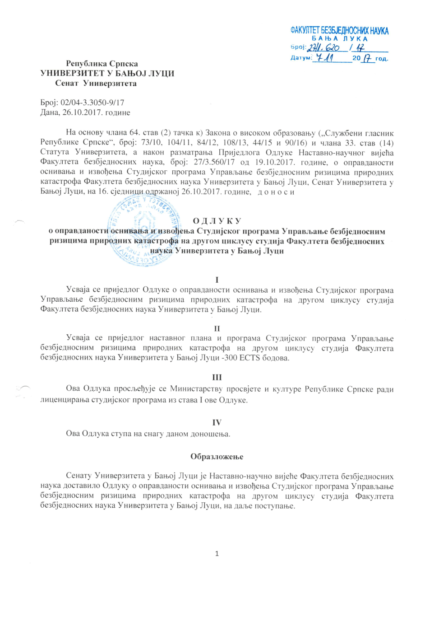
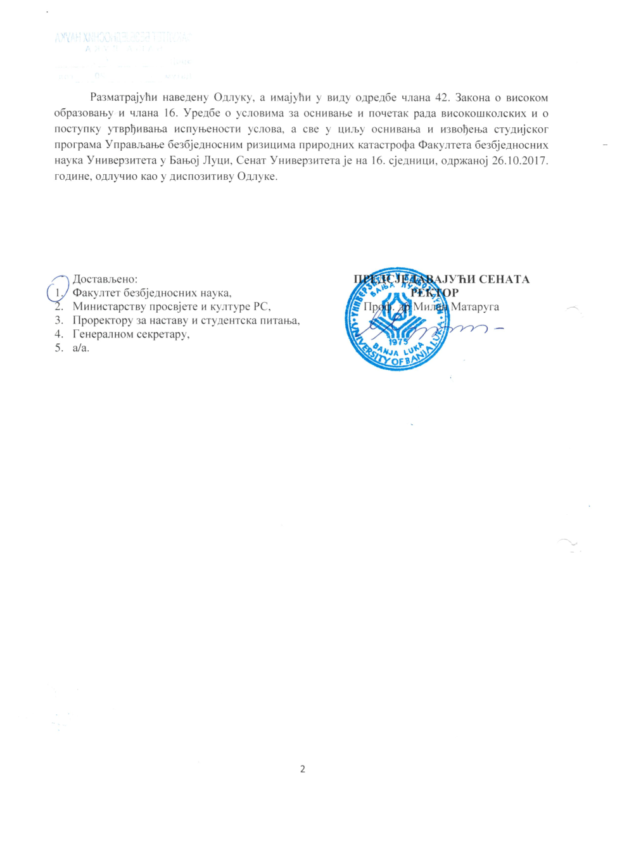
Development of master curricula for natural disasters risk management in Western Balkan countries

